Slide 1

FRAUD DETECTING & BANK PAYMENTS

Slide 2
DMDW MINI PROJECT BY
AREEBA QURESHI (2SA18CS008)
BIBI HAJARA INAMDAR (2SA19CS400)
HURAIN BAKSHI (2SA19CS403)
MUSKAN NAGARDINNI (2SA18CS019)
UNDER THE GUIDANCE OF :
SHRUTI JALAPUR

Slide 3
INDEX:
INTRODUCTION
DATA MINING
TOOLS
DATA PREPROCESSING
K-NEIGHBOURS CLASSIFIER
RESULT
CONCLUSION

Slide 4
INTRODUCTION:
Fraudulent behavior can be seen across many different fields such as e-commerce, healthcare, payment and banking systems. Fraud is a billion-dollar business and it is increasing every year.
Even if fraud seems to be scary for businesses it can be detected using intelligent systems such as rules engines or machine learning

Slide 5
DATA MINING:
Definition simple words, data mining is defined as a process used to extract usable
data from a larger set of any raw data. It implies analysing data patterns in large batches of data using one or more software

Slide 6
TOOLS:
Anaconda: It gives you all the standard packages used in scientific computing in a convenient package without having to worry about installing them all individually with their dependencies
Jupyter Notebook: This article provides a high-level overview of Project Jupyter and the widely popular Jupyter notebook technology. The overarching message I’d like to convey is why you should be using Jupyter for your data science projects.

Slide 7
Data Preprocessing:
In this part we will preprocess the data and prepare for the training.
There are only one unique zip Code values so we will drop them.
Unique zipCodeOri values: 1
Unique zipMerchant values: 1

Slide 8
K-Neighbours Classifier:
K-Nearest Neighbors is one of the most basic yet essential classification algorithms in Machine Learning. It belongs to the supervised learning domain and finds intense application in pattern recognition, data mining and intrusion detection.

Slide 9
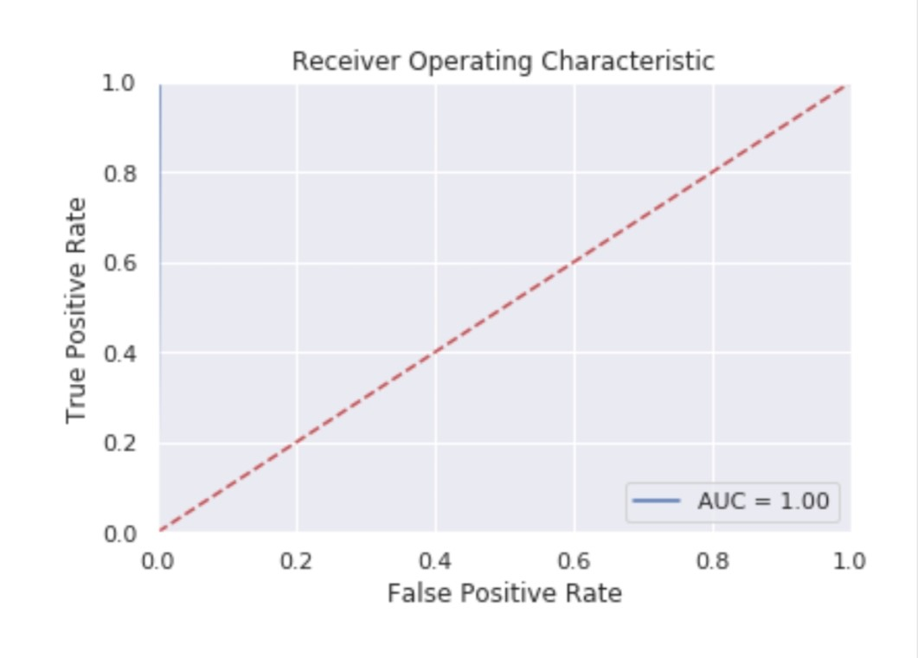
RESULT:

Slide 10
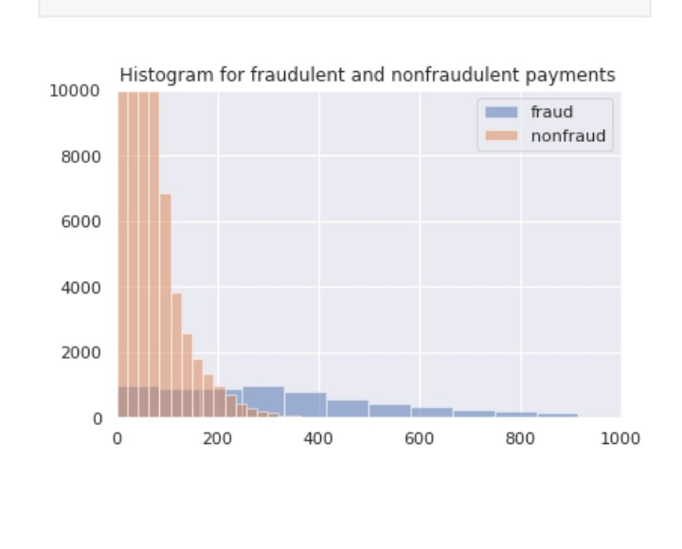

Slide 11
Conclusion:
In this kernel we have tried to do fraud detection on a bank payment data and we have achieved remarkable results with our classifiers. Since fraud datasets have an imbalance class problem we performed an oversampling technique called SMOTE and generated new minority class example

Slide 12
THANK YOU 😊

